Slide 1

Geometry
Unit 11, Lesson 1 Constructing a Circumscribed Circle of a Triangle Volume 2 pg. 177

Slide 2


Benchmark
MA.912.GR.5.3
Construct the inscribed and circumscribed circles of a triangle.
volume 2, pg. 177

Slide 3
Integrated Mathematical Thinking and Reasoning Standards
MA.K12.MTR.1.1 Actively participate in effortful learning both individually and collectively.
MA.K12.MTR.2.1 Demonstrate understanding by representing problems in multiple ways.
MA.K12.MTR.4.1 Engage in discussions that reflect on the mathematical thinking of self and others.
MA.K12.MTR.5.1 Use patterns and structure to help understand and connect mathematical concepts.
MA.K12.MTR.6.1 Assess the reasonableness of solutions.
volume 2, pg. 177

Slide 4

Learning Targets
I can construct the circumscribed circle of a triangle.
I can locate the circumcenter of a triangle.
volume 2, pg. 177

Slide 5

Warm-Up
volume 2, pg. 177

Slide 6
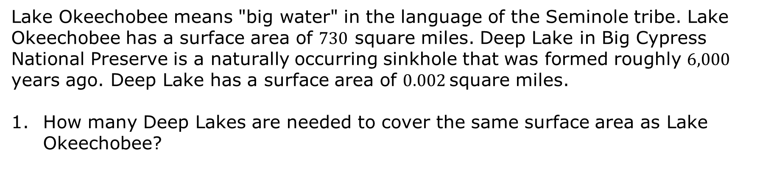
11.1.1 Warm-Up: Lake Okeechobee and Deep Lake
Lake Okeechobee means "big water" in the language of the Seminole tribe. Lake Okeechobee has a surface area of $730$ square miles. Deep Lake in Big Cypress National Preserve is a naturally occurring sinkhole that was formed roughly $6,000$ years ago. Deep Lake has a surface area of $0.002$square miles.
How many Deep Lakes are needed to cover the same surface area as Lake Okeechobee?
volume 2, pg. 177

Slide 7
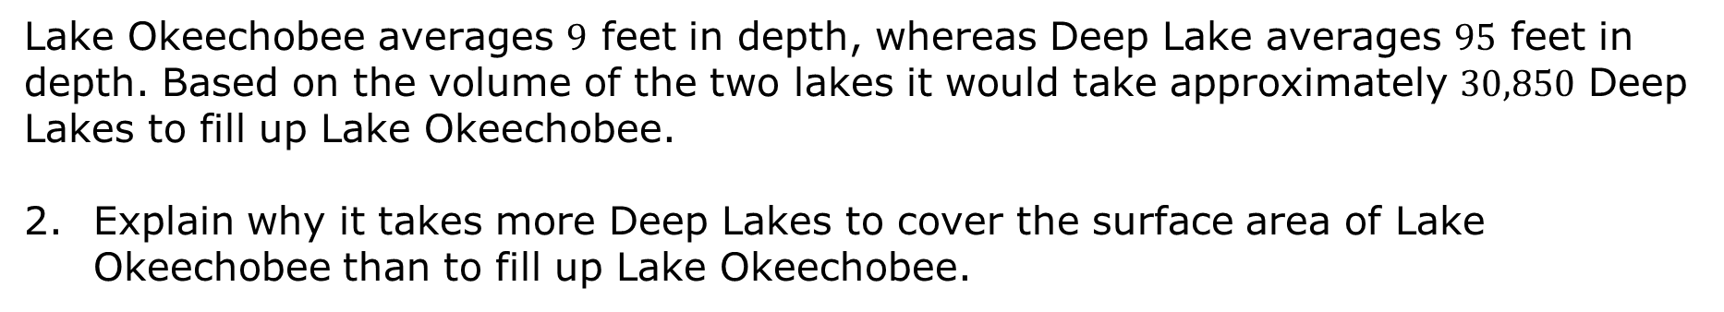
Lake Okeechobee averages $9$ feet in depth, whereas Deep Lake averages $95$ feet in depth. Based on the volume of the two lakes it would take approximately $30,850$ Deep Lakes to fill up Lake Okeechobee.
Explain why it takes more Deep Lakes to cover the surface area of Lake Okeechobee than to fill up Lake Okeechobee.
volume 2, pg. 177

Slide 8

Exploration
volume 2, pg. 178

Slide 9


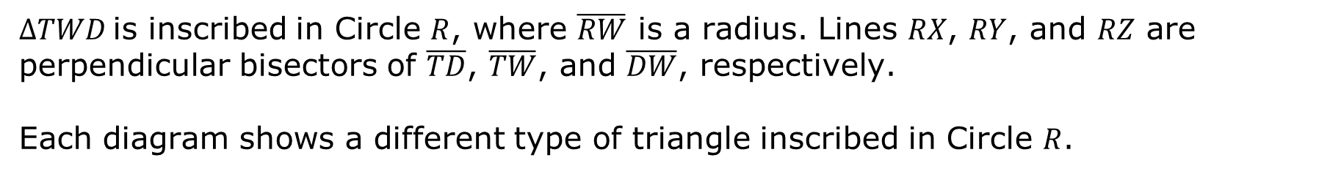
11.1.2 Exploration: Circumscribing A Triangle with A Circle
An inscribed polygon in a circle is a polygon which has all of its vertices on a circle.
$∆TWD$ is inscribed in Circle $R$, where $\overline{RW}$ is a radius. Lines $RX$, $RY$, and $RZ$ are perpendicular bisectors of $\overline{TD}$, $\overline{TW}$, and $\overline{DW}$, respectively.
Each diagram shows a different type of triangle inscribed in Circle $R$.
volume 2, pg. 178

Slide 10
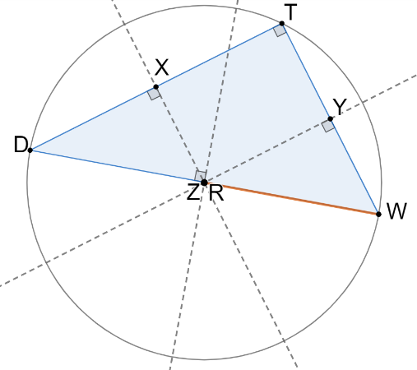
Acute
Right
volume 2, pg. 178

Slide 11
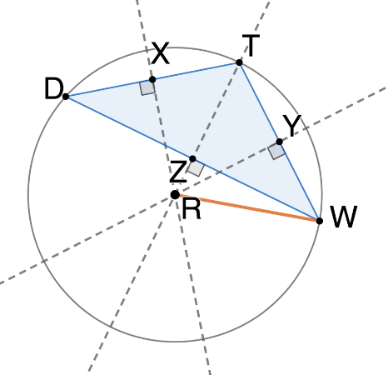
Obtuse
Determine similarities and differences among all three inscribed triangles.
Similarities | Differences
volume 2, pg. 178

Slide 12
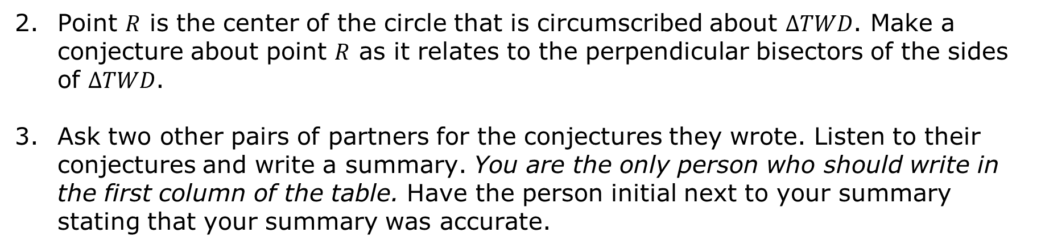
Point $R$ is the center of the circle that is circumscribed about $∆TWD$. Make a conjecture about point $R$ as it relates to the perpendicular bisectors of the sides of $∆TWD$.
Ask two other pairs of partners for the conjectures they wrote. Listen to their conjectures and write a summary. You are the only person who should write in the first column of the table. Have the person initial next to your summary stating that your summary was accurate.
My Summary of Their Conjecture | Initials
volume 2, pg. 178

Slide 13
Review your conjecture with your partner and if necessary, make any changes.
A circumscribed circle is the smallest circle that includes a plane figure. If the figure is a polygon, then the circle must contain all of the vertices of the polygon. Not every polygon has a circumscribed circle, but all triangles and all regular polygons have circumscribed circles.
The point of concurrency is the point where three or more lines intersect.
volume 2, pg. 179

Slide 14
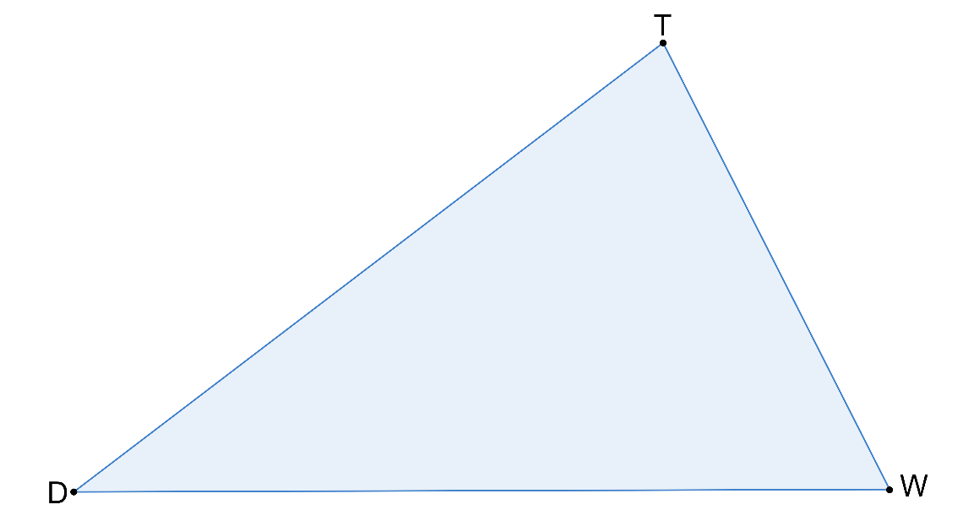

Copy $∆DTW$ onto patty paper. Construct the perpendicular bisectors of each side. Name the point of concurrency of $∆DTW$ point $R$.
Discuss with your partner the relationship point $R$ has with each of the vertices.
volume 2, pg. 179

Slide 15
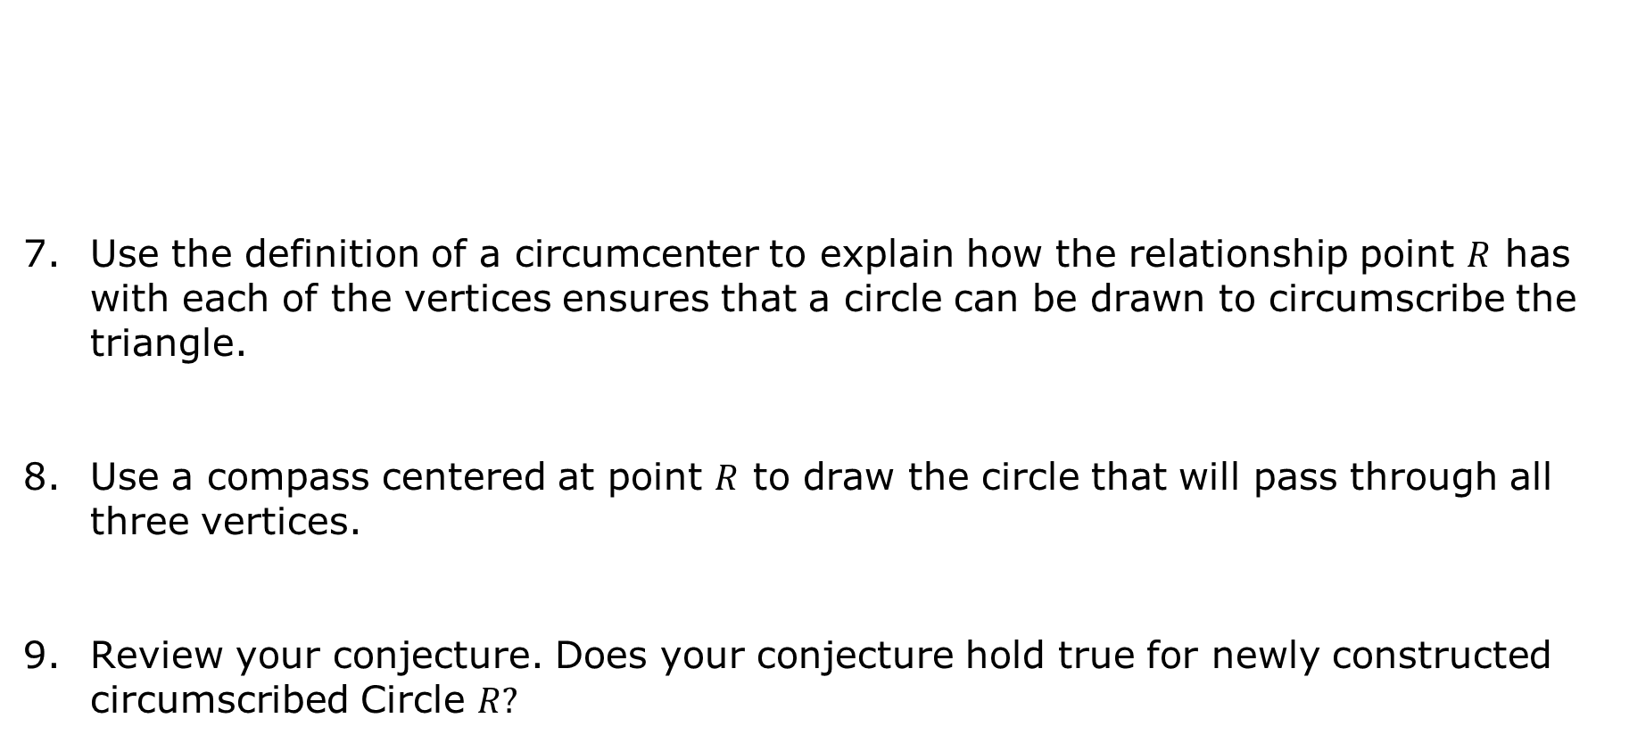
Use the definition of a circumcenter to explain how the relationship point $R$ has with each of the vertices ensures that a circle can be drawn to circumscribe the triangle.
Use a compass centered at point $R$ to draw the circle that will pass through all three vertices.
Review your conjecture. Does your conjecture hold true for newly constructed circumscribed Circle $R?$
The point of concurrency of the perpendicular bisectors of a triangle (the center of a triangle’s circumscribed circle) is the circumcenter.
volume 2, pg. 179

Slide 16
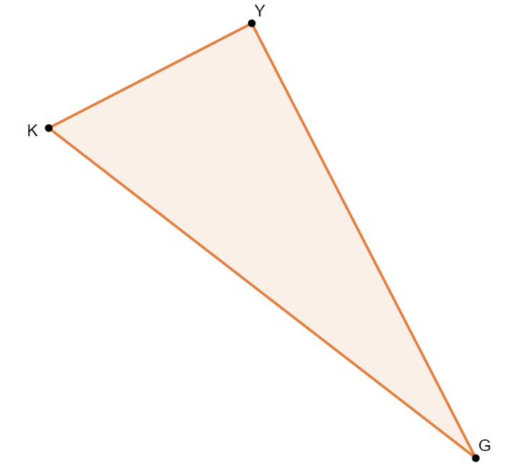
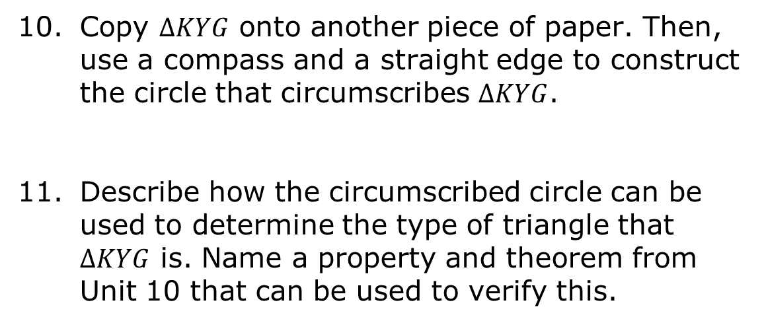
Copy $∆KYG$ onto another piece of paper. Then, use a compass and a straight edge to construct the circle that circumscribes $∆KYG$.
Describe how the circumscribed circle can be used to determine the type of triangle that $∆KYG$ is. Name a property and theorem from Unit 10 that can be used to verify this.
volume 2, pg. 180

Slide 17
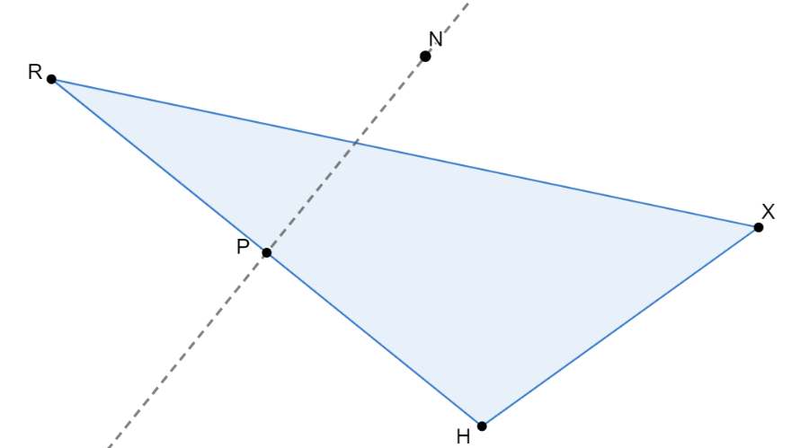
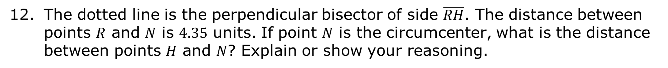
The dotted line is the perpendicular bisector of side $\overline{RH}$. The distance between points $R$ and $N$ is $4.35$ units. If point $N$ is the circumcenter, what is the distance between points $H$ and $N$? Explain or show your reasoning.
volume 2, pg. 180

Slide 18
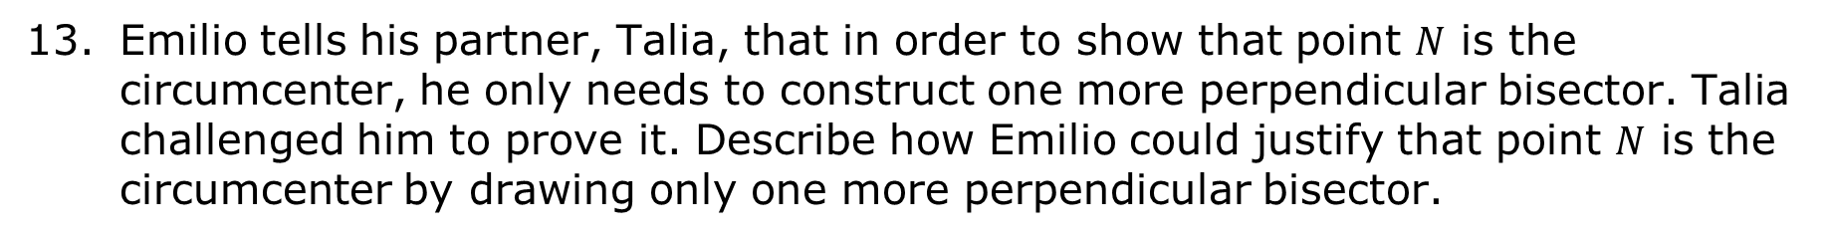
Emilio tells his partner, Talia, that in order to show that point $N$ is the circumcenter, he only needs to construct one more perpendicular bisector. Talia challenged him to prove it. Describe how Emilio could justify that point $N$ is the circumcenter by drawing only one more perpendicular bisector.
volume 2, pg. 181

Slide 19

Wrap-Up
volume 2, pg. 181

Slide 20
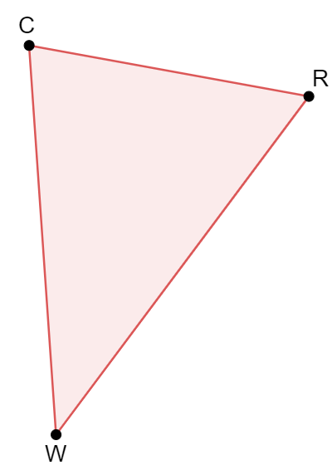
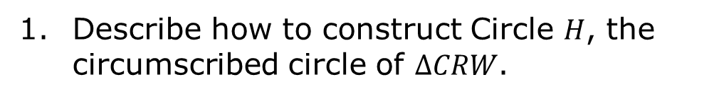
11.1.3 Wrap-Up: Ticket Out the Door
Describe how to construct Circle $H$, the circumscribed circle of $∆CRW$.
volume 2, pg. 181

